Slide 1
Failure Prediction CIRCA
Date: 11th December 2025

Slide 2
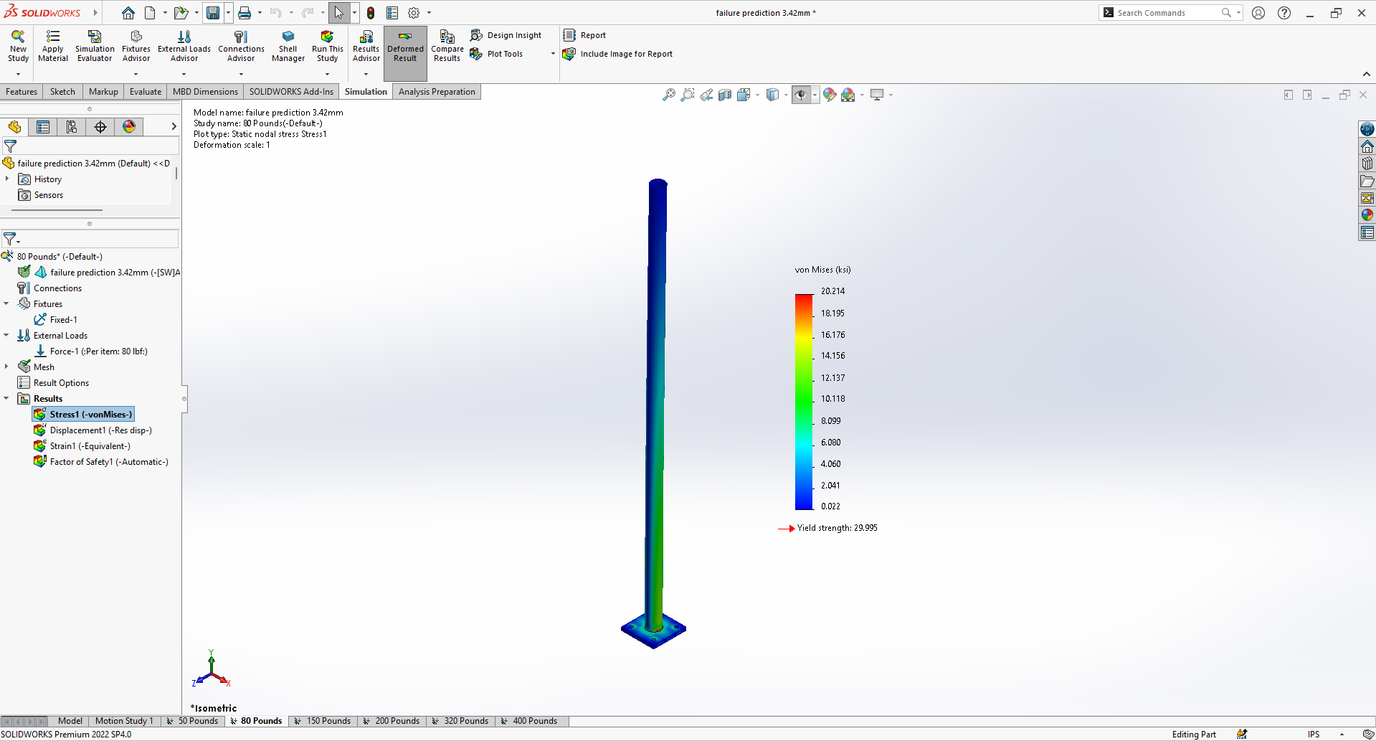
Problem statement: To create AI agent in VS code to predict circa post stress, deflection or failure prediction
using linear regression machine learning technique at given criteria of load & material thickness.

Slide 3
Procedure/steps:
Created CAD model of required sub assembly i.e., 2-inch diameter Circa 5 ft height.
Run simulations to generate training data of analysis results.
Here actually ran all possible simulations for 50, 80, 150, 200, 320, 400 Pounds for 2-inch diameter Circa
with various thickness 1.24, 1.65, 2, 2.5, 3, 3.42 mm, respectively.
4) Created an excel or csv file of analysis results in tabular format.
5) In VS code, pasted that result file. Created AI agent & given prompt for instruction to GPT-5 mini model for asking to predict stress & deflection values of let’s say an example, 80 Pound load with 1.24 mm thick Circa post. This is testing data for model evaluation.
6) Model learned from training data. It created code & gave answer which tried to match to our training actual data.
7) In this way as preliminary check for such post, we can predict result values without jumping to simulation activity directly.

Slide 4
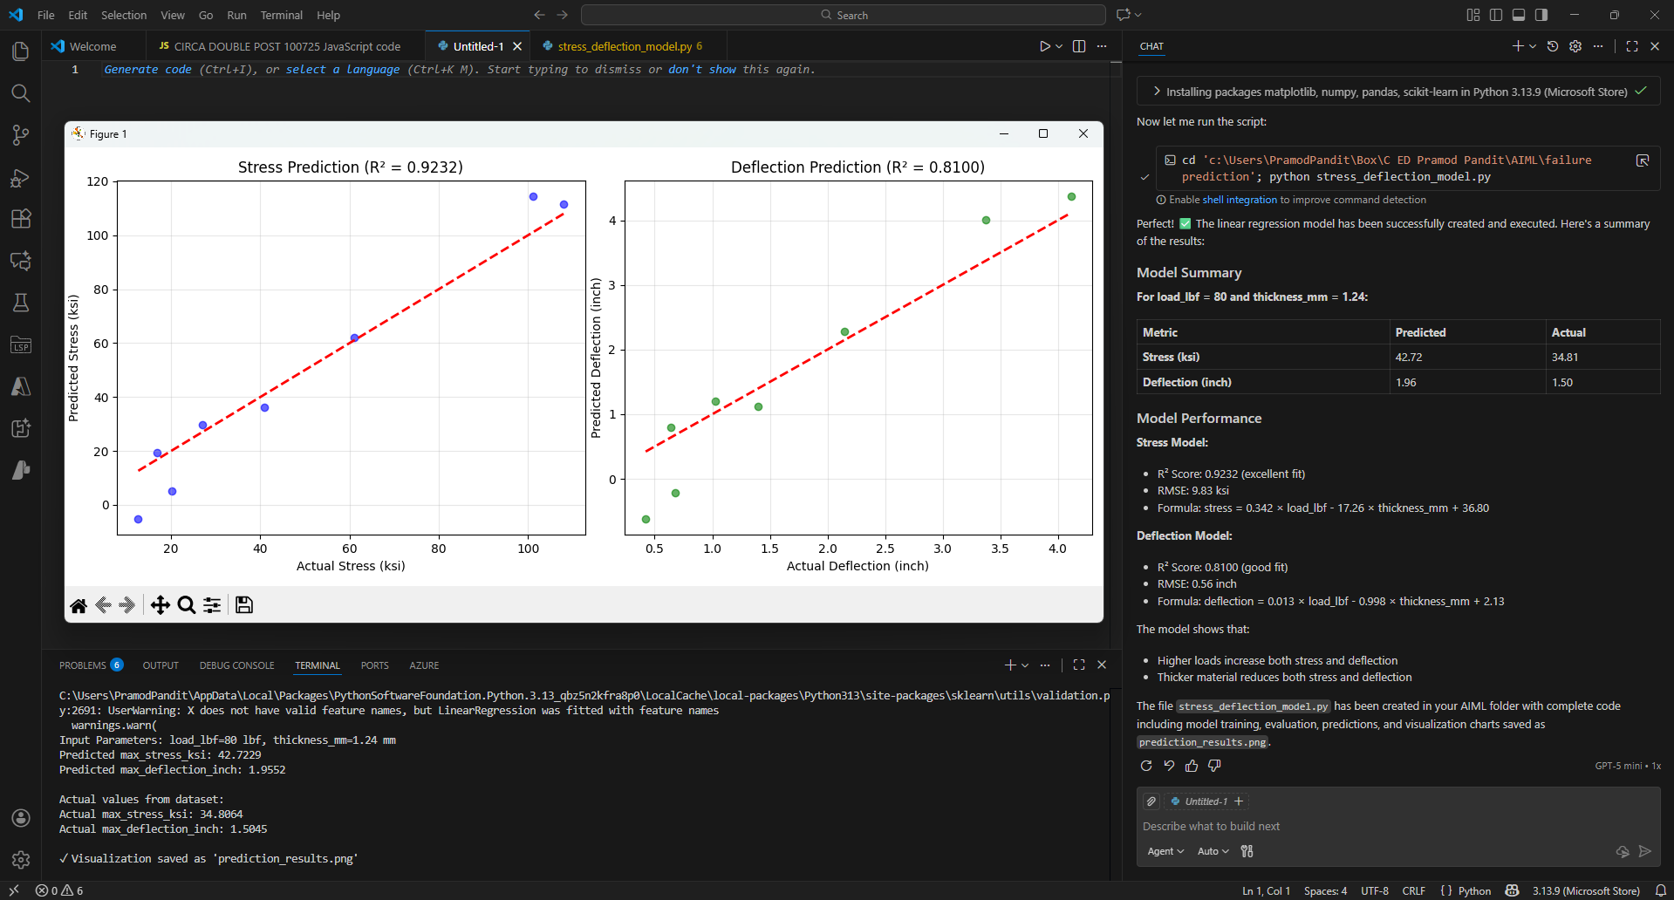
VS code UI & summary:

Slide 5
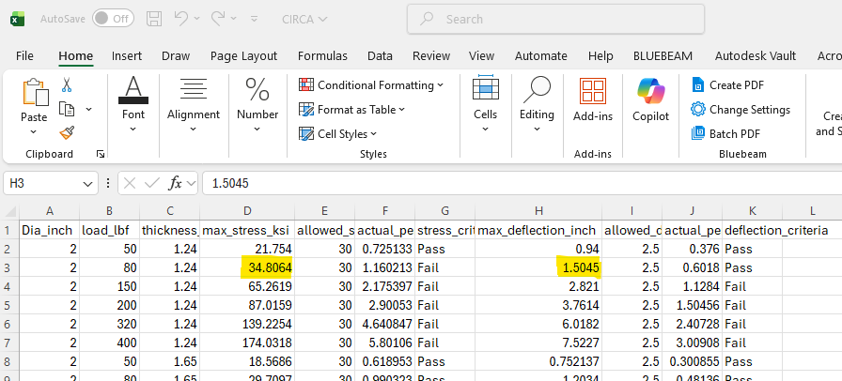
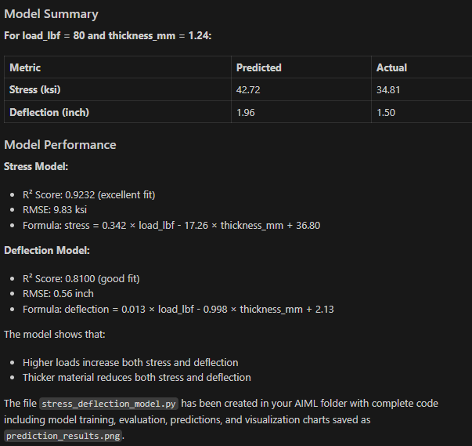
Test data predicted result without SOLIDWORKS SIMULATION
Training data actual results
with SOLIDWORKS SIMULATION
Verifying training set or known values

Slide 6
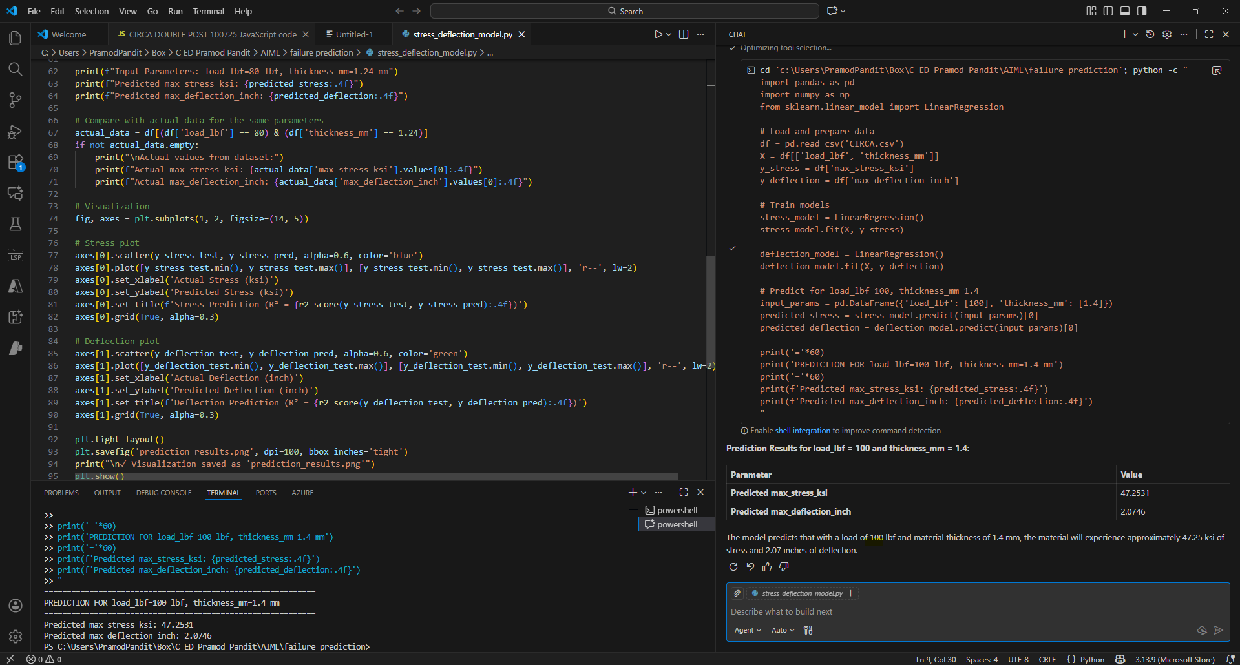
Verifying for unknown values

Slide 7
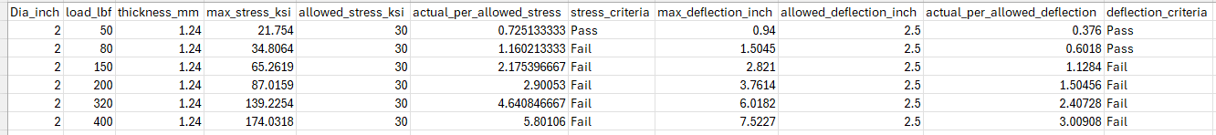
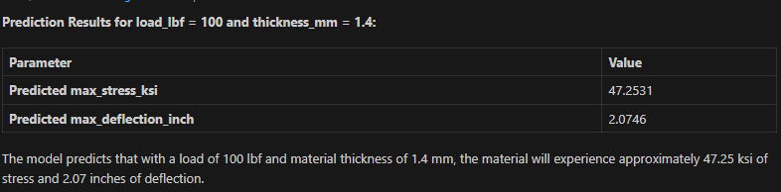
Training data as input
Unknown data as output
Finding for new values of load 100 lbf & thickness 1.4mm

